Slide 1
🐧Penguins🐧

Slide 2

Preliminary: Reinforcement Learning
Reinforcement learning is a type of machine learning.
It allows an agent to learn by interacting with an environment.
The agent receives rewards for positive actions and punishments for negative ones.
The goal is to maximize the cumulative reward over time.
🐧

Slide 3
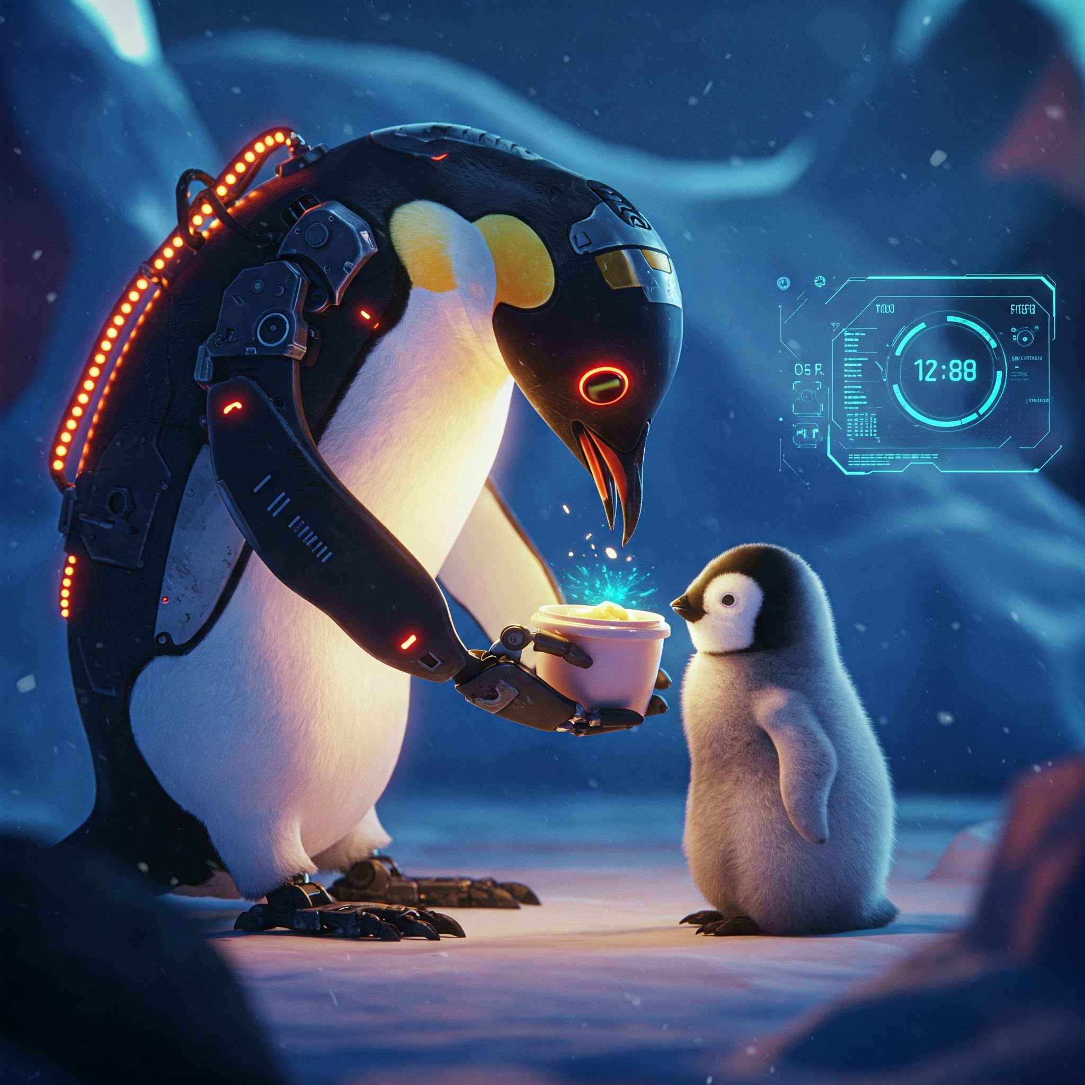
PPO vs MORL
Simple PPO: Agent learns a single task within an environment.
Multi-Objective RL (MORL): Agent learns multiple objectives/tasks.
Our Implementation
Time constraint - Complete task quickly.
Movement conservation - Minimize energy use.
Feeding baby penguin - Primary goal.
🐧

Slide 4
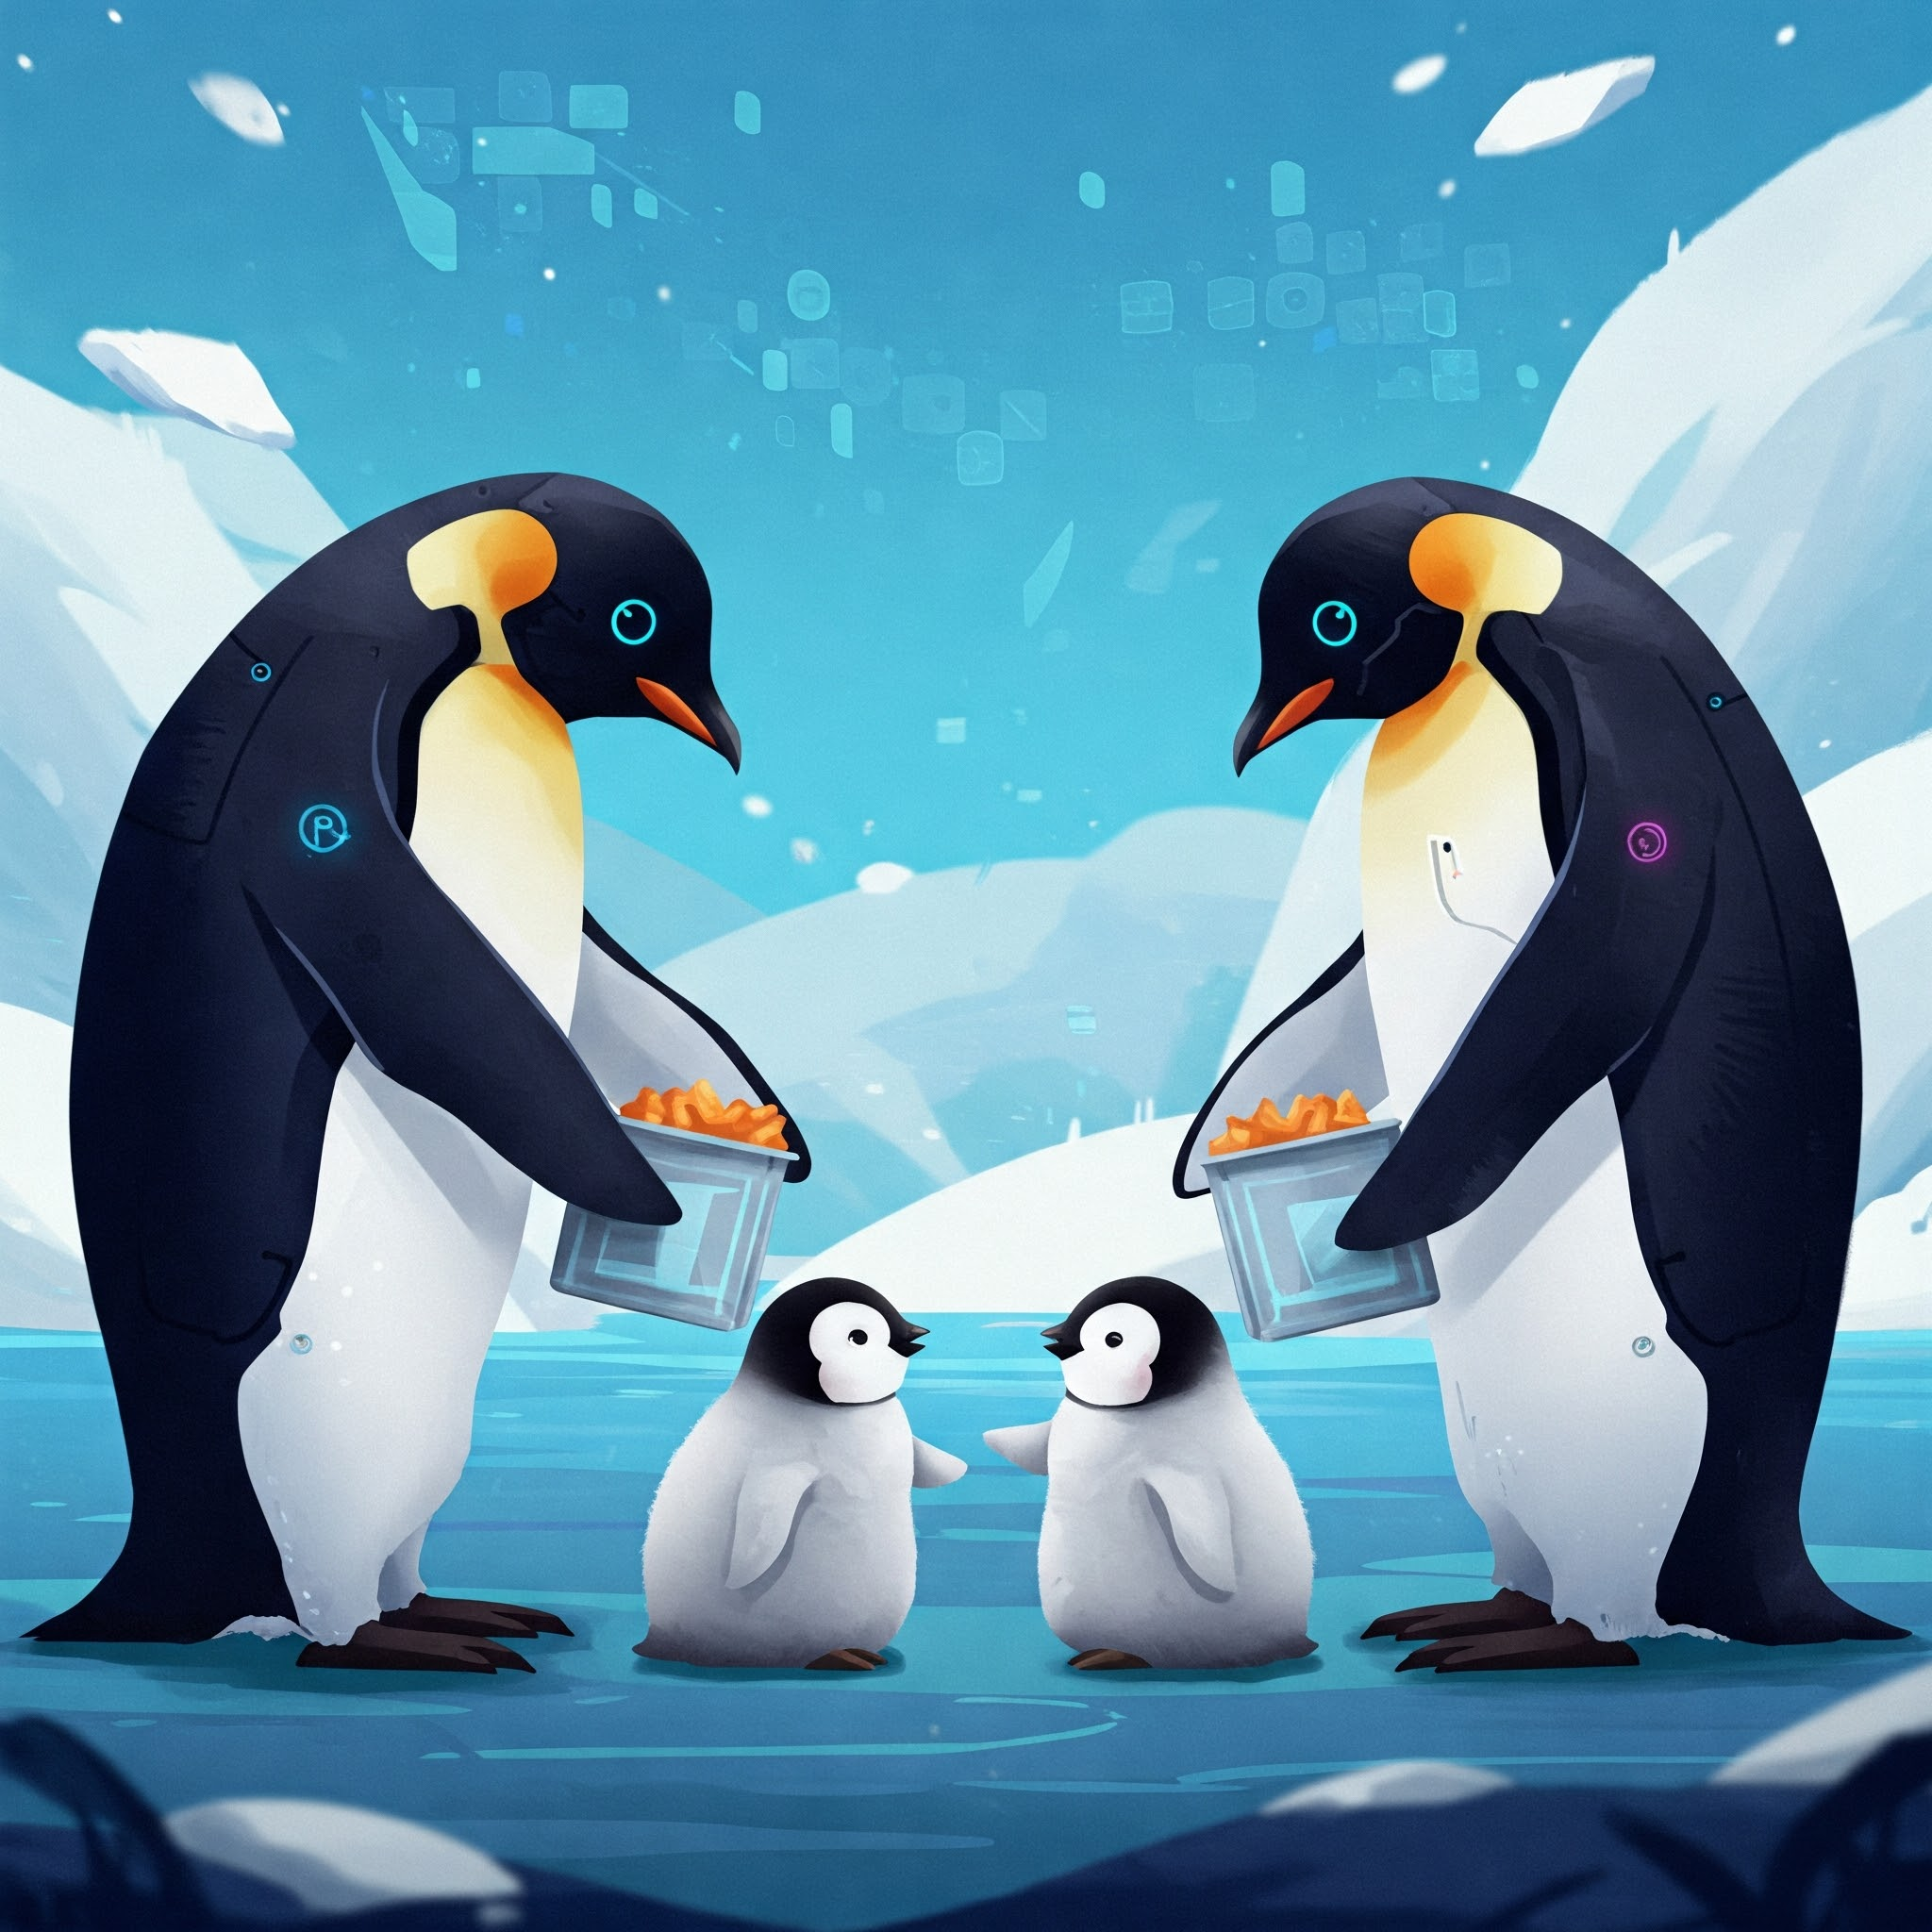
PPO vs MORL Analysis
Observing Penguin Agent Actions: Compare PPO and MORL agents' actions at each timestep.
Essence of Research: Analyze why the agents take specific actions.
PPO vs MORL: Does MORL optimize for time and energy while feeding the baby penguin?
Potential PPO Issues: Does PPO lead to wandering or excessive time-wasting?
🐧

Slide 5
PPO Configuration Details
trainer_type: ppo
batch_size: 128
Determines the number of experiences (state, action, reward, next state) that are grouped together for a single update of the neural network during training.
buffer_size: 2048
Defines the total number of experiences collected from the environment before a policy update is performed.
learning_rate: 0.0003
It determines how much the policy adjusts its parameters based on the gradients calculated during training.
num_epoch: 3
Specifies the number of passes the PPO algorithm makes through the collected experience buffer during one policy update.
max_steps: 1000000
Determines the maximum number of steps of interaction (or frames of simulation) that the agent takes with the environment before training is terminated.

Slide 6
Experiment Overview & Setup
Goal
Train a "Penguin" agent using Proximal Policy Optimization (PPO).
Framework: ML-Agents v1.1.0, PyTorch v2.2.2+cu121
Configuration
Both runs used the same training configuration file (config/ppo/Penguin.yaml).
Agent Implementation
Run Penguin_01: PenguinSimpleAgent.cs (Basic reward structure)
Run Penguin_06: PenguinAgent.cs (Reward shaping / MORL-inspired structure)
Total Steps: Both runs completed ~1 million steps.
🐧

Slide 7
Learning Dynamics: Agent Behavior
Metric 1: Mean Episode Length (Steps per episode, late training)
Penguin_01: ~253 steps
Penguin_06: ~248 steps
Observation: Higher-performing agent (06) finished episodes slightly faster.
This aligns with its reward structure penalizing movement, encouraging efficiency.
🐧

Slide 8
Learning Dynamics: Agent Behavior
Metric 2: Policy Entropy (Measure of policy randomness, late training)
Penguin_01: ~0.562
Penguin_06: ~0.549
Observation: Penguin_06 had slightly lower entropy, suggesting its learned policy might be slightly more deterministic or "confident", likely due to the clearer goal and efficiency incentives.
🐧

Slide 9
Learning Signals - Loss Functions
Metric 1: Policy Loss (How much the policy action probabilities are updated)
Penguin_01: ~0.0694
Penguin_06: ~0.0703
Observation: Very similar values. The core PPO update mechanism behaved similarly in magnitude.
🐧

Slide 10
Learning Signals - Loss Functions
Metric 2: Value Loss (Error in predicting future rewards)
Penguin_01: ~0.1308
Penguin_06: ~0.4058
Observation: Penguin_06 had a significantly higher average value loss.
This doesn't mean worse learning. Predicting the state values for the much higher-reward and potentially more complex trajectory learned by Penguin_06 was likely harder for the value network.
🐧

Slide 11
Penguin_01: The "Simple" Agent
Objective: Feed the baby penguin.
Reward Logic:
+1f reward for eating a fish.
+1f reward for successfully feeding the baby.
Small negative reward (-1f / MaxStep) per step.
🐧

Slide 12
Penguin_06: The "MORL-Inspired" Agent
Objective: Feed the baby penguin efficiently.
Reward Logic:
+1f reward for eating a fish.
+3f reward for feeding the baby (stronger goal incentive).
Small negative reward (-1f / MaxStep) per step.
-0.0002f penalty for moving forward.
-0.0002f penalty for turning.
🐧

Slide 13
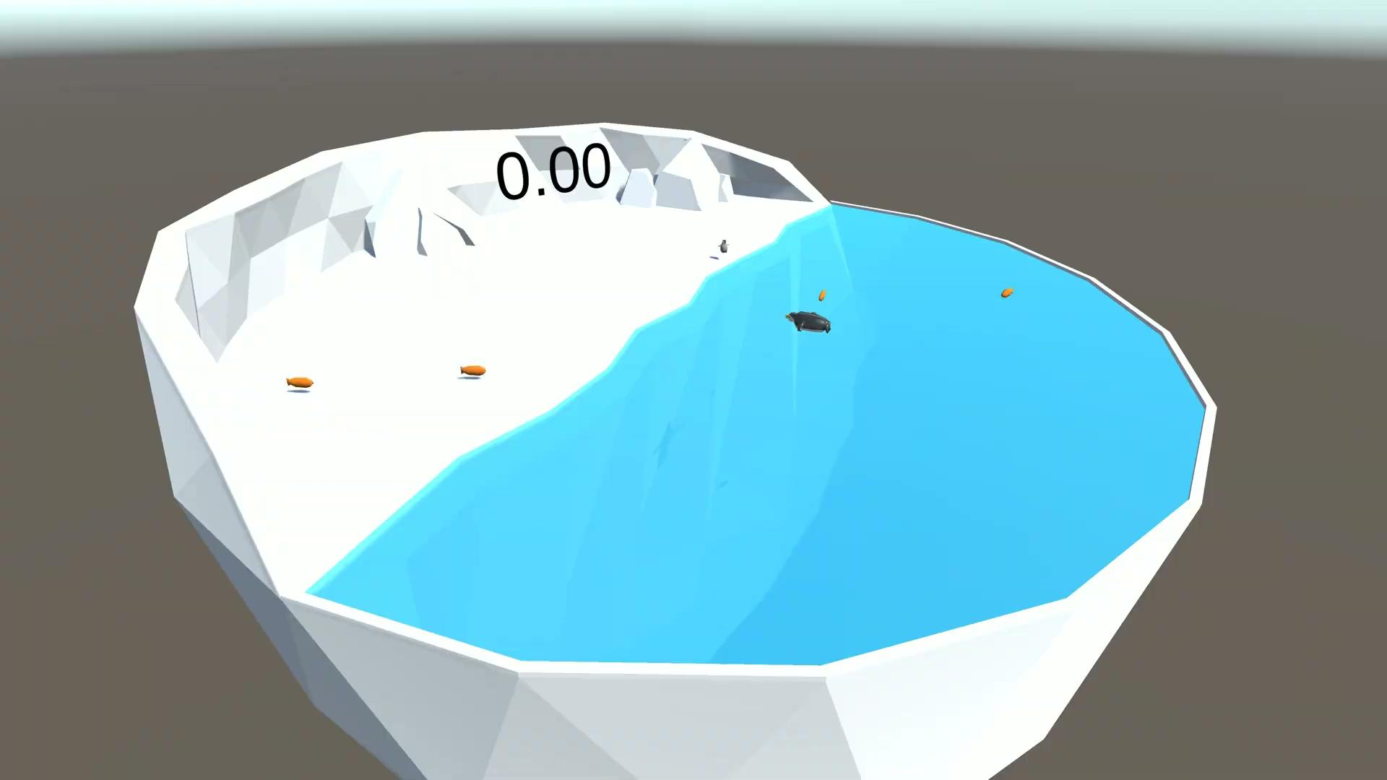

Video Comparison
Penguin_01
Penguin_06
🐧

Slide 14
Conclusion & Discussion
Reward Shaping is Crucial: Agent implementation impacts outcomes more than hyperparameter tuning.
Clear Goals Drive Learning: Stronger primary objective reward led to significantly better results.
Complexity vs. Performance: Sophisticated reward shaping yields better policies but may need more tuning/training.
Incentivize Efficiency: Small penalties for actions effectively guide efficient solutions.
🐧

Slide 15
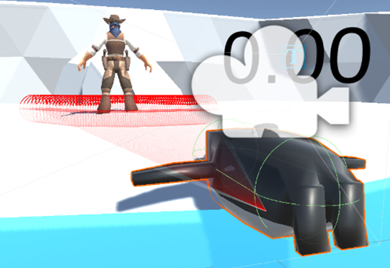
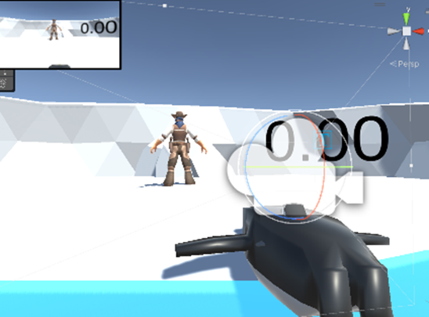
Visual perception
3D Lidar
Camera
🐧

Slide 16
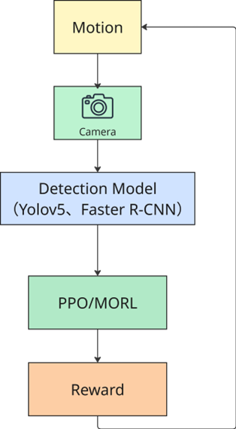
Visual perception
▰ The image data generated by the camera will be used as the main observation input for the intelligent body to support subsequent deep visual perception tasks;
▰ Compared to simple distance sensors (e.g., laser or radar), image inputs can provide richer semantic information (e.g., recognizing the location and type of fish/penguin).
🐧

